Slide 1
Creating and Configuring Virtual Machine Settings

Slide 2
Overview
Exam Objective 3.1: Create and Configure Virtual Machine Settings
Virtualizing Servers
Installing Hyper-V
Using Hyper-V Manager
Configuring Resource Metering
Notes:
Lecture notes go here

Slide 3
Virtualizing Servers
Creating and Configuring Virtual
Machine Settings
Notes:
Lecture notes go here

Slide 4
Virtualization Architectures
Type II Virtualization
Requires a “host” operating system
Using the Type II Hypervisor, you create a virtual hardware environment for each VM
Install a “guest” operating system on each VM, just like installing a new computer
The host operating system shares access to the computer’s processor with the hypervisor
Does not provide the same performance as separate physical computers
Good testing or lab environment

Slide 5
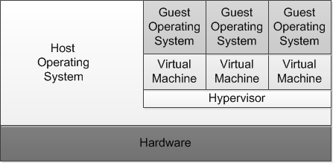
Virtualization Architectures
A hybrid VMM sharing hardware access with a host operating system

Slide 6
Virtualization Architectures
Type I Virtualization
Hypervisor is an abstraction layer that interacts directly with the computer’s physical hardware
No host operating system required
Individual environments, called partitions have their own operating systems installed and accesses hardware through the hypervisor
No host operating system is sharing processor
Parent partition runs the virtualization stack which creates and manages the child partitions

Slide 7
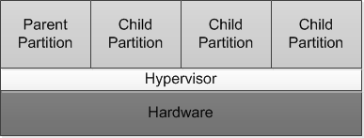
Virtualization Architectures
A Type 1 VMM, with the hypervisor providing all hardware access

Slide 8
Hyper-V Implementations
Hyper-V role is required for the operating system to function as the computer’s parent partition, enabling it to host VMs.
Only Standard and Datacenter editions support Hyper-V.
No special requirements are needed for the guest operating systems (Microsoft or non-Microsoft).

Slide 9
Hyper-V Licensing
You must have licenses for both physical and virtual instances of the operating system.
Datacenter licensing allows you to create and run an unlimited number of VMs.
Standard provides 2 virtual instances only.

Slide 10
Hyper-V Hardware Limitations
Windows Server 2012 R2 Hyper-V host system:
Up to 320 logical processors
Supporting up to 2,048 virtual CPUs
Up to 4 TB of physical memory
One server can host as many as 1,024 active VMs
Each VM can have up to 64 virtual CPUs and up to 1 TB of memory
Hyper-V can support clusters with up to 64 nodes and 8,000 VMs

Slide 11
Hyper-V Server
Subset of Windows Server 2012 R2
Free downloadable product, but does not include licenses for operating systems installed in the VMs
Includes the Hyper-V role and limited File and Storage services and Remote Desktop capabilities
Hyper-V role is installed by default
Only uses Server Core interface

Slide 12
Installing Hyper-V
Creating and Configuring Virtual
Machine Settings
Notes:
Lecture notes go here

Slide 13
Installing Hyper-V
Installing the Hyper-V role installs the hypervisor software and Hyper-V Manager (GUI only)
Recommendations:
Use Hyper-V role on the host without any other roles
Put other roles on VMs
Use Server Core installation

Slide 14
Hyper-V Hardware Requirements
64-bit processors that include hardware-assisted virtualization.
A system BIOS that supports the virtualization hardware, on which the virtualization feature has been enabled.
Hardware-enforced Data Execution Prevention (DEP), which Intel describes as eXecuted Disable (XD) and AMD describes as No eXecute (NS).

Slide 15
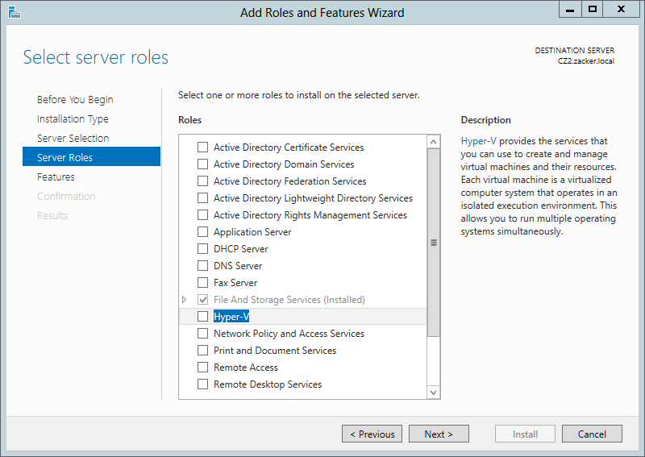
Install the Hyper-V Role
The Select Server Roles page of the Add Roles and Features Wizard

Slide 16
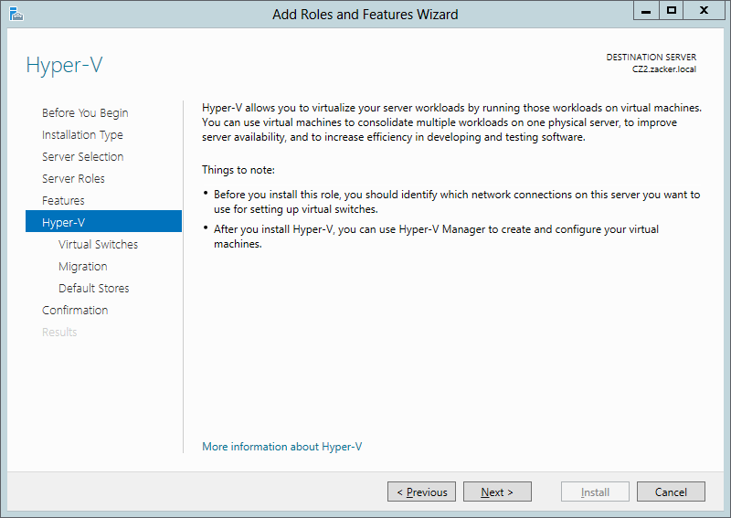
Install the Hyper-V Role
The Hyper-V page of the Add Roles and
Features Wizard

Slide 17
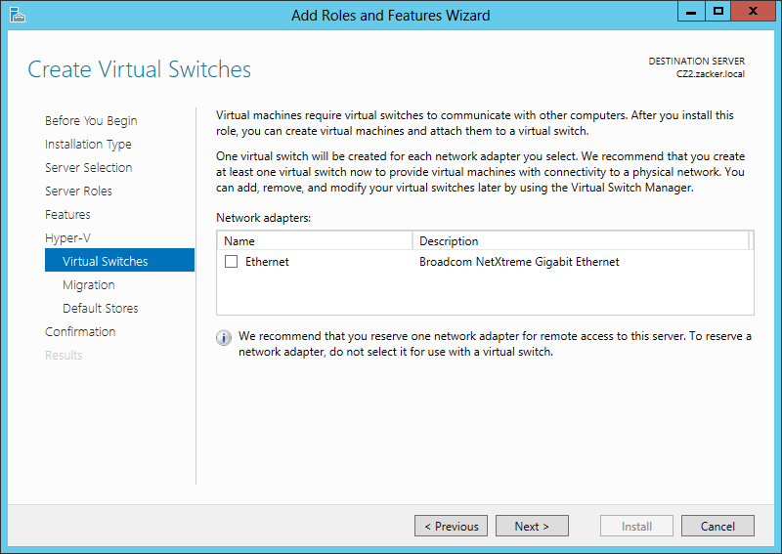
Install the Hyper-V Role
The Create Virtual Switches page of the Add Roles and Features Wizard

Slide 18
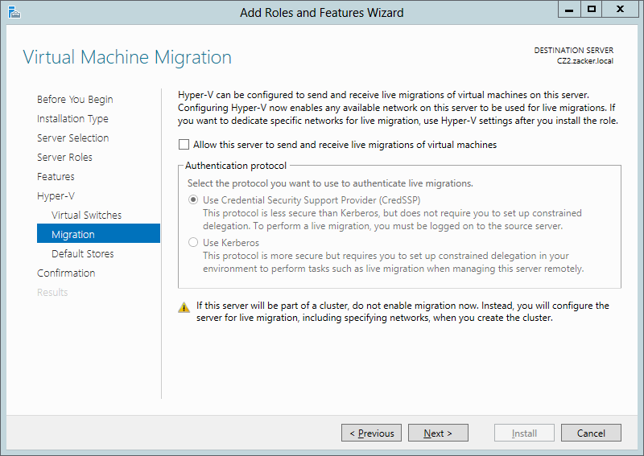
Install the Hyper-V Role
The Virtual Machine Migration page of the Add Roles and Features Wizard

Slide 19
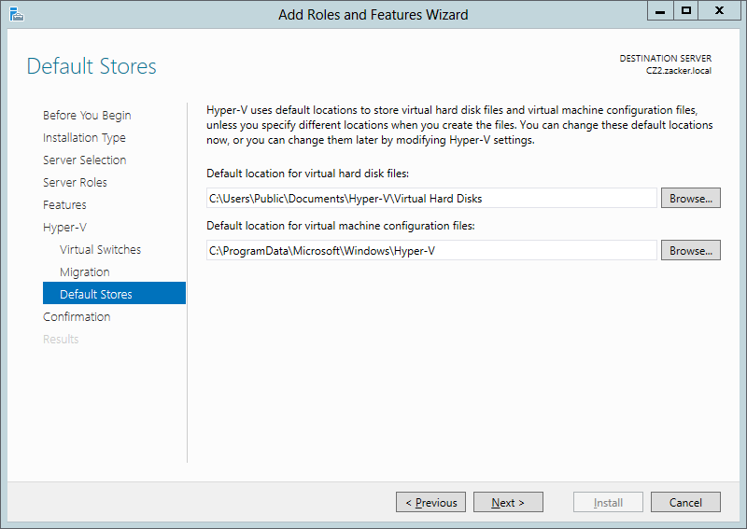
Install the Hyper-V Role
The Default Stores page of the Add Roles and
Features Wizard

Slide 20
Using Hyper-V Manager
Creating and Configuring Virtual
Machine Settings
Notes:
Lecture notes go here

Slide 21
Using Hyper-V Manager
The primary graphical tool for creating and managing VMs
Can be used to manage VMs on multiple servers
Installed with the Hyper-V Role, or you can install the Hyper-V Management Tools feature, or RSAT package for Windows 8

Slide 22
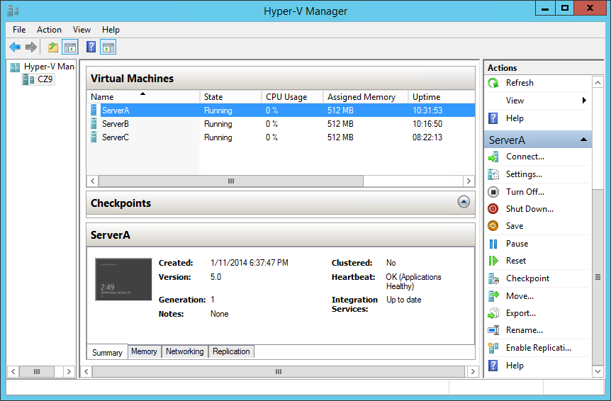
Using Hyper-V Manager
The Hyper-V Manager console

Slide 23
Creating a Virtual Machine
To create a virtual machine (VM), you define the hardware resources that the system should allocate to them:
Number of processors
Memory
Virtual network adapters
Virtual disks

Slide 24
Creating a Virtual Machine
Each virtual machine uses the following files:
Virtual machine configuration (.vmc) file: This file in XML format contains the VM configuration information, including all settings for the VM.
Virtual hard disk (.vhd or .vhdx) files: One or more files used to store the guest operating system, applications, and data for the VM.
Saved-state (.vsv) file: The VM may use this if it has been placed into a saved state.

Slide 25
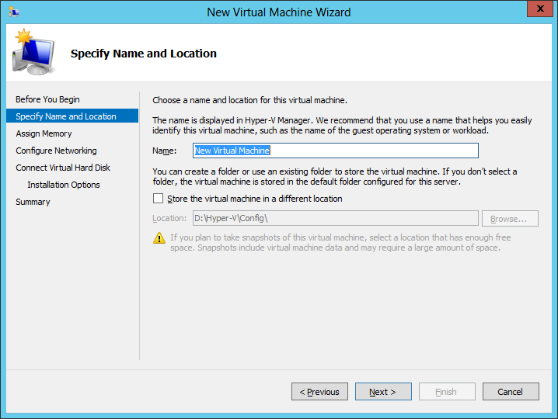
Creating a Virtual Machine
The Specify Name and Location page of the New Virtual Machine Wizard

Slide 26
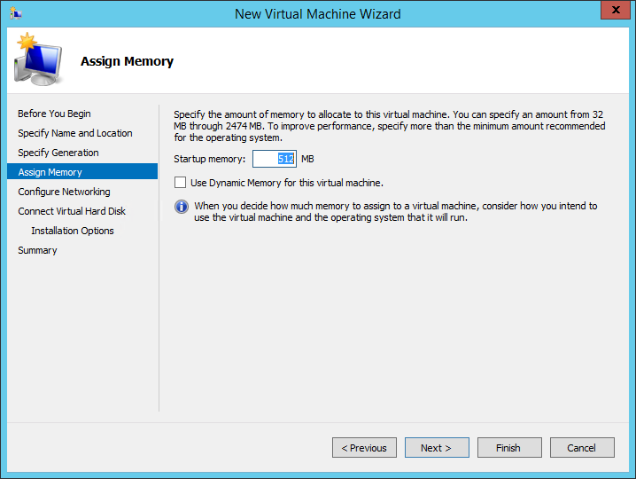
Creating a Virtual Machine
The Assign Memory page of the New Virtual
Machine Wizard

Slide 27
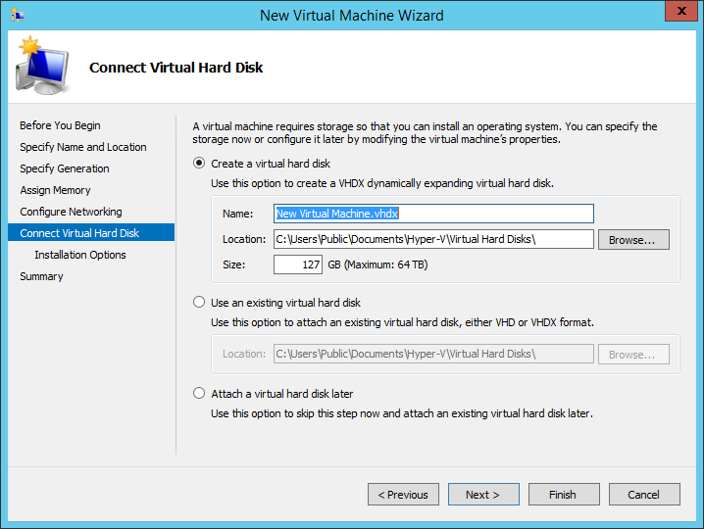
Creating a Virtual Machine
The Connect Virtual Hard Disk page of the New Virtual Machine Wizard

Slide 28
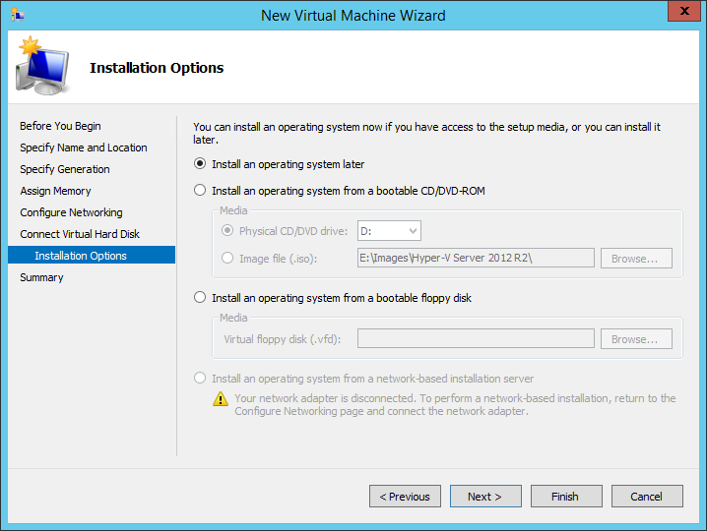
Creating a Virtual Machine
The Installation Options page of the New Virtual Machine Wizard

Slide 29
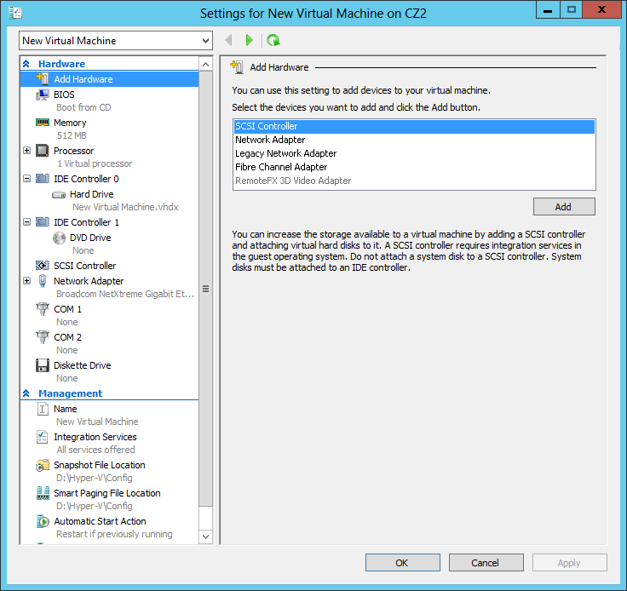
Creating a Virtual Machine
The Settings dialog box for a virtual machine

Slide 30
Creating Generation 1 and Generation 2 VMs
Generation 1 VMs are designed to emulate the hardware found in a typical computer, and to do this, they use drivers for specific devices, such as an AMI BIOS, an S3 graphics adapter, and an Intel chipset and network adapter. Generation 1 VMs that you create with Windows Server 2012 R2 Hyper-V are completely compatible with all previous Hyper-V versions.

Slide 31
Creating Generation 1 and Generation 2 VMs
In Windows Server 2012 R2, the Hyper-V implementation includes a new type of virtual machine, which it refers to as Generation 2.
Generation 2 VMs use synthetic drivers and software-based devices instead, and provide advantages that include the following:
UEFI boot
SCSI disks
Generation 2 VMs only support Windows Server 2012, Windows Server 2012 R2, and Windows 8 (64-bit).

Slide 32
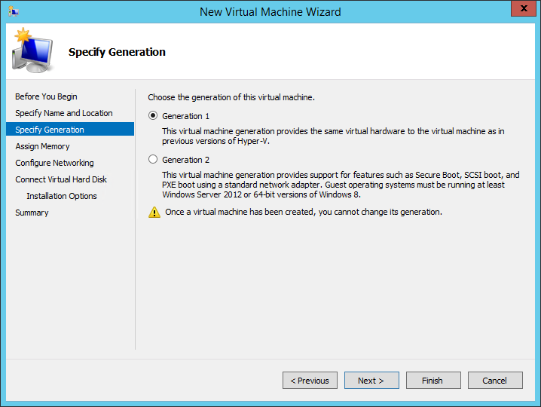
Creating Generation 1 and Generation 2 VMs

Slide 33
Installing an Operating System
Hyper-V in Windows Server 2012 supports the following as operating systems you can install in virtual machines:
Windows Server 2012 R2
Windows Server 2012
Windows Server 2008 R2
Windows Server 2008
Windows Home Server 2011
Windows Small Business Server 2011
Windows Server 2003 R2
Windows Server 2003 SP2
Windows 8 (including Windows 8.1)
Windows 7 Enterprise and Ultimate
Windows Vista Business, Enterprise, and Ultimate SP2
Windows XP Professional SP3
Windows XP x64 Professional SP2
CentOS 6.0–6.2
Red Hat Enterprise Linux 6.0–6.2
SUSE Linux Enterprise Server 11 SP2

Slide 34
Installing an Operating System
To start an installation from a DVD, or image file, you must configure the VM’s virtual DVD drive in the Settings dialog box. Enter one of the following options:
None: The equivalent of a drive with no disk inserted.
Image file: Points to a disk image file with an .iso extension stored on one of the host computer’s drives or on a shared network drive.
Physical CD/DVD drive: Links the virtual DVD drive to one of the physical DVD drives in the host computer.

Slide 35
Configuring Guest Integration Services
Some of the functions added to solve compatibility issues with guest operating systems (OSs):
Operating system shutdown: Enables the Hyper-V Manager console to remotely shut down a guest OS in a controlled manner, eliminating the need for an administrator to log on and manually shut the system down.
Time synchronization: Enables Hyper-V to synchronize the OS clocks in parent and child partitions.
Data Exchange: Enables the OSs on the parent and child partitions to exchange information, such as OS version information and fully qualified domain names.
Heartbeat: Implements a service in which the parent partition sends regular heartbeat signals to the child partitions, which are expected to respond in kind. A failure of a child partition to respond indicates that the guest OS has frozen or malfunctioned.
Backup: Allows backup of Windows VMs using Volume Shadow Copy Services.

Slide 36
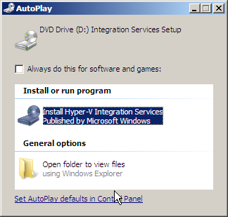
Install Guest Integration Services
Launching Hyper-V Integration Services

Slide 37
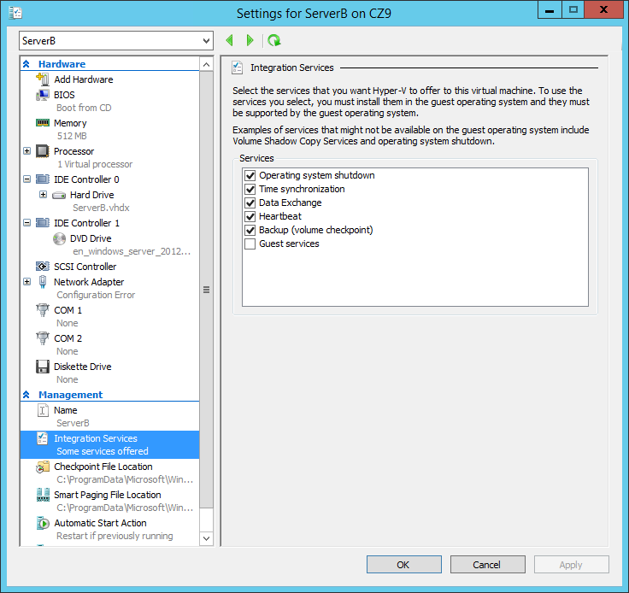
Installing Guest Integration Services
Integration Services settings for a virtual machine

Slide 38
Using Enhanced Session Mode
In previous versions of Hyper-V, when you open a Virtual Machine Connection window in the Hyper-V Manager console, you receive mouse and keyboard connectivity, plus a limited cut and paste functionality.
To obtain any further access, such as audio or print functionality, you could establish a Remote Desktop Services connection to the VM, but this requires the computers to be connected to the same network, which is not always possible.

Slide 39
Using Enhanced Session Mode
Starting in Windows Server 2012 R2, Hyper-V supports an enhanced session mode that enables the Virtual Machine Connection window to redirect any of the following local resources to VMs running Windows Server 2012 R2 or Windows 8.1:
Display configuration
Audio
Printers
Clipboard
Smart cards
USB devices
Drives
Supported Plug and Play devices

Slide 40
Allocating Memory
When you create a new VM you specify the amount of memory allocated to the VM.
Based on the amount of physical memory on the computer.
Change the allocated memory by shutting down the VM, opening Settings, and changing the Startup Ram setting.
Experiment to find the optimum performance.

Slide 41
Using Dynamic Memory
Allows the VM to automatically reallocate memory to the VM from a shared memory pool as its demands change
Must be enabled by selecting the Enable Dynamic Memory check box on the VM’s memory page, and the following settings must be configured:
Startup RAM
Minimum RAM
Maximum RAM
Memory Buffer
Memory Weight

Slide 42
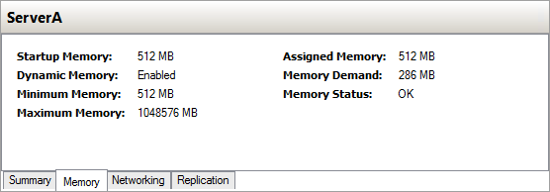
Monitor Memory Allocation
Memory statistics for a virtual machine

Slide 43
Configure Smart Paging
Smart paging is a new feature.
If a VM has to restart, and there is not enough memory available to allocate its Startup RAM value, the system uses hard disk space to make up the difference and begins paging memory contents to disk.
Because of slow disk access, performance degrades.
Select the fastest possible hard drive for the Smart Paging file.

Slide 44
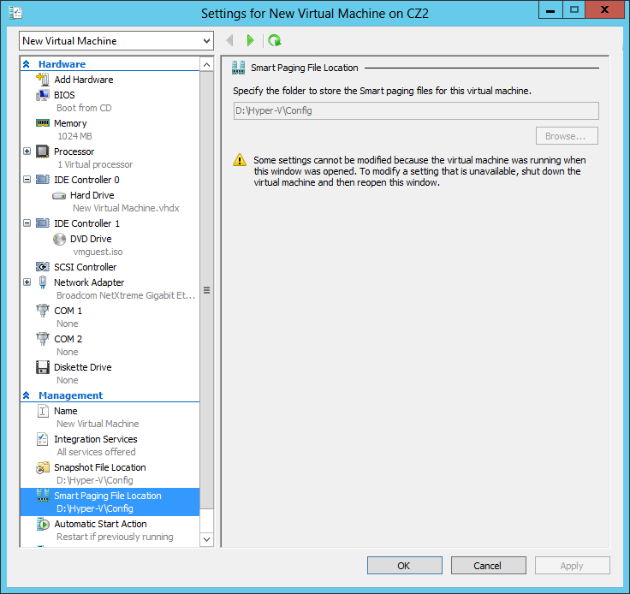
Configure Smart Paging
The Smart Paging File Location page in a VM’s Settings dialog box

Slide 45
RemoteFX
RemoteFX is a Windows Server feature that enables remote computers to connect Hyper-V guest VMs with an enhanced desktop experience:
It includes:
Graphics adapter virtualization
USB redirection
Intelligence encoding and decoding
Notes:
Graphics adapter virtualization: With an appropriate graphics adapter installed in the server, client systems can offload some of the graphics processing tasks they would normally perform locally. By rendering graphics on a high-performance adapter installed on the host server and sending the resulting bitmaps to the client in a highly-compressed format, RemoteFX conserves resources on the client system, as well as network bandwidth.
USB redirection: Enables USB devices connected to client computers to be redirected to the host server, including printer, scanner, interface, storage, and audio devices.
Intelligent encoding and decoding: The RemoteFX server can encode data using the system’s CPU, GPU, or dedicated hardware. In the same way, the client system can decode incoming data using its CPU, GPU, or a hardware decoder. The systems can select different codecs, depending on the data type.

Slide 46
RemoteFX
To use RemoteFX with Hyper-V, you need:
The server's CPU must support Second Level Address Translation (SLAT), which must be enabled.
For Windows Server 2012,/Windows Server 2012 R2, at least one DirectX 11.1 capable graphics card with a WDDM 1.2 driver must be installed on the server.
Requires the Remote Desktop Virtualization Host role.
In Hyper-V Manager, you must select RemoteFX 3D Video Adapter, then specify the screen resolution and number of monitors.
When installing RemoteFX, the host machine cannot be a Domain Controller.

Slide 47
Configuring Resource Metering
Creating and Configuring Virtual
Machine Settings
Notes:
Lecture notes go here

Slide 48
Resource Metering
Resource metering uses PowerShell cmdlets to track a variety of performance metrics for individual VMs, including:
CPU utilization
Minimum/Maximum/Average memory utilization
Disk space utilization
Incoming/Outgoing network traffic

Slide 49
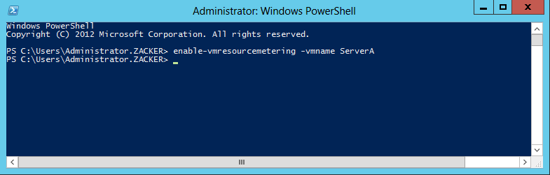
Configuring Resource Metering
Enabling Resource Metering with Windows PowerShell

Slide 50
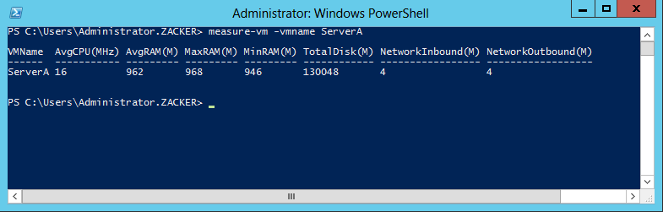
Configuring Resource Metering
Displaying metering data with Windows PowerShell

Slide 51
Lesson Summary
Virtualization is a process that adds a layer of abstraction between actual, physical hardware and the system making use of it. Instead of having the server access the computer’s hardware directly, an intervening component called a hypervisor creates a virtual machine environment, and the server operating system runs in that environment.
Virtualization is the process of deploying and maintaining multiple instances of an operating system, called virtual machines (VMs), on a single computer.
Microsoft Hyper-V is a hypervisor-based virtualization system for x64 computers starting with Windows Server 2008. The hypervisor is installed between the hardware and the operating system and is the main component that manages the virtual computers.
Notes:
Lecture notes go here

Slide 52
Lesson Summary
For licensing purposes, Microsoft refers to each virtual machine that you create on a Hyper-V server as a virtual instance. Each Windows Server 2012 version includes a set number of virtual instances; you must purchase licenses to create additional ones.
To keep a small footprint and minimal overhead, Hyper-V Server contains only the Windows Hypervisor, Windows Server driver model, and virtualization components.
Notes:
Lecture notes go here

